Slide 1
Air Quality – L6
Virendra Sethi
vsethi@iitb.ac.in
7809

Slide 2
Thought Exercise
How would you size and count aerosol particles in the nanometer size range ?

Slide 3
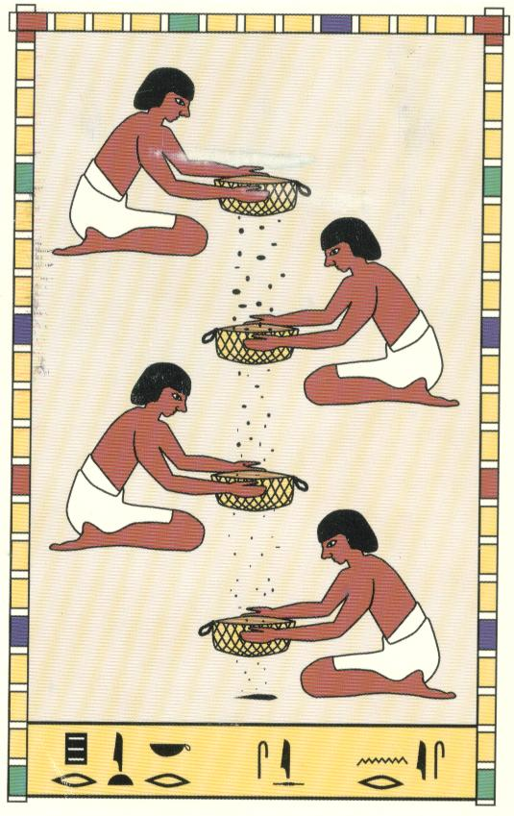

Slide 4
Instrumentation
Inertial Impactors
  Mass based (> 56 nm)
Optical Particle Counters
  Number based (> 100 nm)
Electrical Mobility
  Sizing (> 6 nm)
  Counting (Condensation Nuclei Counters)

Slide 5
OPC’s
Light Scattering
Light Extinction
  Limited to 0.09 μm
  0.4 > λ_{opt} > 0.7 μm
Single Particle /Cloud of Particles

Slide 6
Laser Source, λ
I_{scatter}
I_{scatter}
Particle Size

Slide 7
Instrumentation
Inertial Impactors
  Mass based (> 56 nm)
Optical Particle Counters
  Number based (> 100 nm)
Electrical Mobility
  Sizing (> 3 nm)
  Counting (Condensation Nuclei Counters)

Slide 8
Electrical Mobility Analysers
Charge particles
Electrical Field
SIZE
CPC
OPC in Principle – Alcohol used to grow size

Slide 9
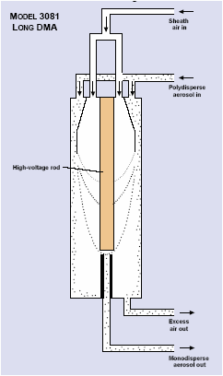
Differential Mobility Analyser (For size separation using electrical mobility)
Source : TSI Inc.

Slide 10
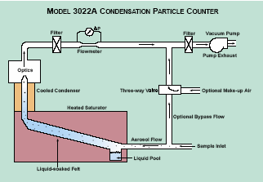
Condensation Particle Counter (For growing the size separated particles and detecting them using light scattering)
Source : TSI Inc.

Slide 11
Instrumentation
Inertial Impactors
  Mass based (> 56 nm)
Optical Particle Counters
  Number based (> 100 nm)
Electrical Mobility
  Sizing (> 3 nm)
  Counting (Condensation Nuclei Counters)

Slide 12
Other Instruments For Routine Field Studies
High Volume Samplers (1.2 Lakhs)
  Regulatory (PM10m SOx, NOx)
Mini-vol Samplers (2 Lakhs)
  Regulatory (PM10, PM2.5)
Dust Trak (4 Lakhs) RESEARCH
  Real time (1 minute resolution)
  PMx (x = 1, 2.5, 4, 10)

Slide 13
Reflection
Measurement of Particle size is important
What are the three principles that one can use to size and count particles ?

Slide 14
Admin Matter
Home Work 1 is due on Monday Aug 31
Still under finalisation
  Weightage for grades Quiz/HW : Finals
  Mode of exam (and when)

Slide 15
So far…
How to size and count particles
Now, how to control emissions from the Industries
Two kinds of air pollutants
  Gaseous (Ants)
  Particulate (Elephants)

Slide 16
Control of
Particulate Pollutants

Slide 17
Air Pollution Control - PM
MECHANICAL
  Gravity – Settling Chambers 20 -100 μm
  Inertia - Cyclones > 25 μm
  Diffusion – Filters > 0.1 μm
ELECTRICAL
  Electrostatic Precipitators > 0.1 μm

Slide 18
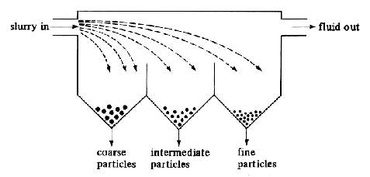
Mechanical
Gravitational Settlers

Slide 19
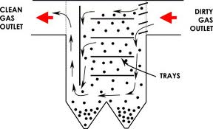

Slide 20
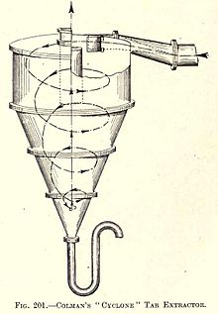
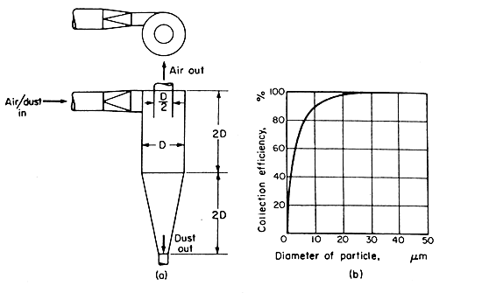
Mechanical - Inertia

Slide 21
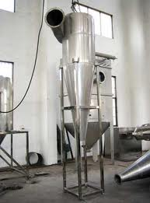

Slide 22
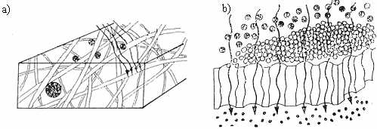
Mechanical - Filtration

Slide 23

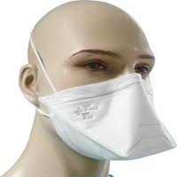
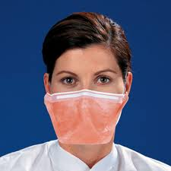

Slide 24
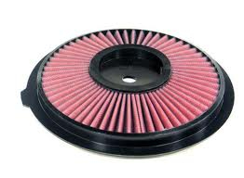
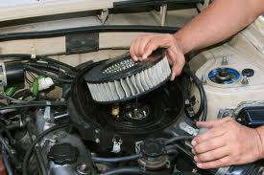
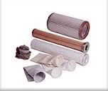
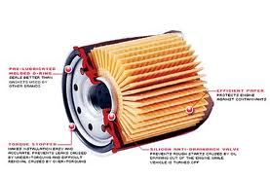

Slide 25
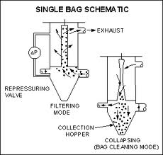

Slide 26
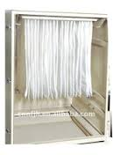

Slide 27
Through Fibrous Material :
  FILTERED by
    Diffusion
    Impaction
    Interception
    (NOT SIEVING)

Slide 28
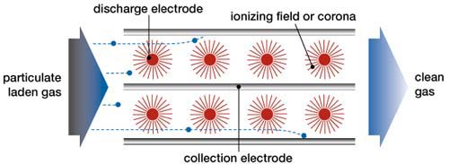
Electrostatic Precipitators
(Particle are charged and then attracted to the collection electrodes)

Slide 29
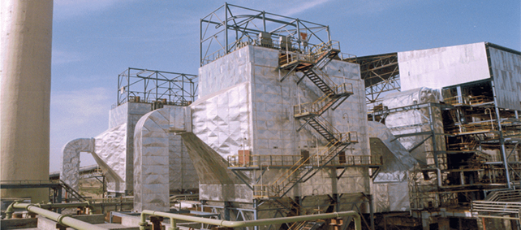

Slide 30
Air Pollution Control - PM
MECHANICAL
  Gravity – Settling Chambers 20 -100 μm
  Inertia - Cyclones > 25 μm
  Diffusion – Filters > 0.1 μm
ELECTRICAL
  Electrostatic Precipitators > 0.1 μm

Slide 31
Thank you
Monday Class
REVIEW and
Key Questions for Exam

